Slide 1
Regression in Data Analytics

Slide 2
Review - Regression
Fairly similar to classification, however, the target to predict is of numeric types
Example:
Predict monthly product sales based on product types, categories, advertising spends, etc.
Predict first year GPA based on students’ majors and high school grades in different classes
Predict wildfire area based on location and weather
Etc.
Similar to classification, to train a regression model, the training data must include both the features and the labels
This is referred to as Supervised Learning – a branch of machine learning in which models need both features and labels to learn
StudentID | Major | HSMath | HSEnglish | HSScience
001 | IT | 3.5 | 3 | 3.4
002 | CS | 3.5 | 3.6 | 3.6
003 | IT | 3.0 | 3.1 | 2.8
004 | SWE | 2.9 | 2.8 | 2.9
005 | BIO | 3.1 | 3.2 | 3.1
FYGPA
3.2
3.7
2.9
2.9
3.2

Slide 3
Regression Models in this Module
“Models” refer to the algorithms that we will be using to solve an analytical tasks
Classification models are algorithms that are designed for the classification task. They are trained to map input feature data to output class targets
Models we will discuss in this module
Scikit-learn models:
Linear Regression
Support Vector Regressor, Decision Tree, and Random Forest (adapted to regression)
Neural Network (and classifier version)
AWS SageMaker models:
Extreme Gradient Boosting (XGBoost) Model (adapted to regression)
Linear Learner (and classifier version)
001 | IT | 3.5 | 3 | 3.4
Model
3.2
002 | CS | 3.5 | 3.6 | 3.6
Model
3.7
003 | IT | 3.0 | 3.1 | 2.8
Model
2.9

Slide 4
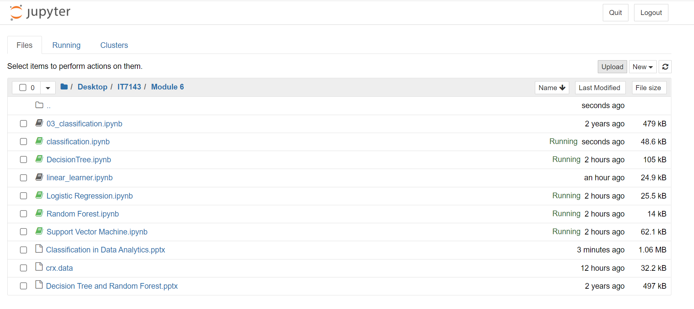
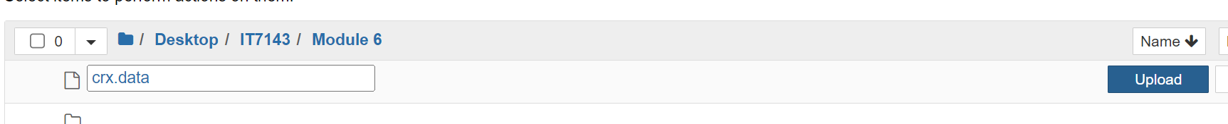
Uploading Data to SageMaker Notebook
We use the credit approval data for examples in this module. You need to upload the data and the sample notebook to the server as follows
Start the SageMaker Jupyter like the tutorial in Module 5
When the Jupyter Environment finishes starting up, open Jupyter GUI
Click on Upload. You will be prompted to select the files. Do not forget to click on the Upload button for each individual file

Slide 5
Linear Regression

Slide 6
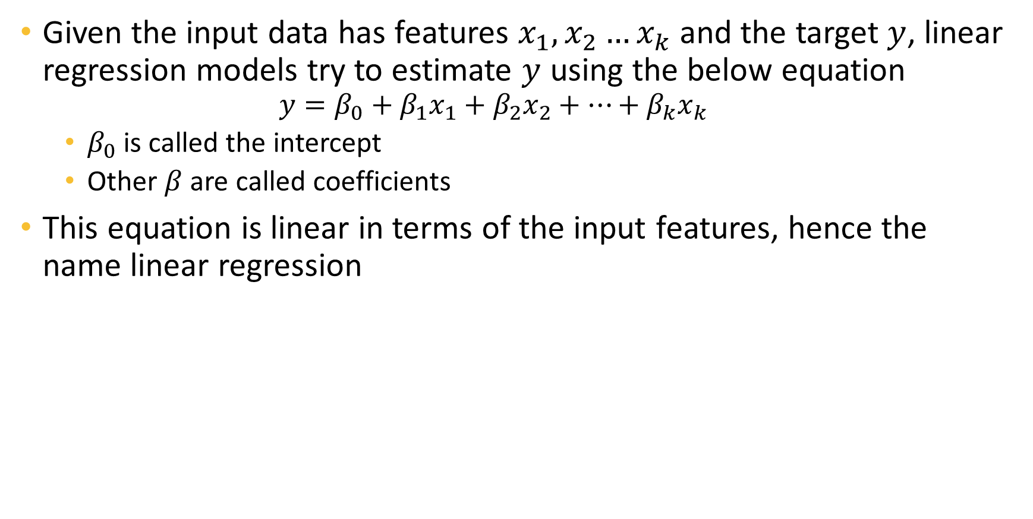
Linear Regression Model
Given the input data has features $x_{1},x_{2}…x_{k}$ and the target $y$, linear regression models try to estimate $y$ using the below equation
$$y=β_{0}+β_{1}x_{1}+β_{2}x_{2}+…+β_{k}x_{k}$$
$β_{0}$ is called the intercept
Other $β$ are called coefficients
This equation is linear in terms of the input features, hence the name linear regression

Slide 7
Linear Regression Example
Return to the student GPA, we can train a logistic regression in this data
The equation may look like
Then, we can “plug” the actual numbers from each student to obtain their predicted FYGPA
StudentID | Major | HSMath | HSEnglish | HSScience
001 | IT | 3.5 | 3 | 3.4
002 | CS | 3.5 | 3.6 | 3.6
003 | IT | 3.0 | 3.1 | 2.8
004 | SWE | 2.9 | 2.8 | 2.9
005 | BIO | 3.1 | 3.2 | 3.1
FYGPA
3.2
3.7
2.9
2.9
3.2
$$\hat{y}=1+0.4Math+0.25English+0.2Science$$
Prd. FYGPA
3.0
3.5
3.2
3.0
3.1

Slide 8
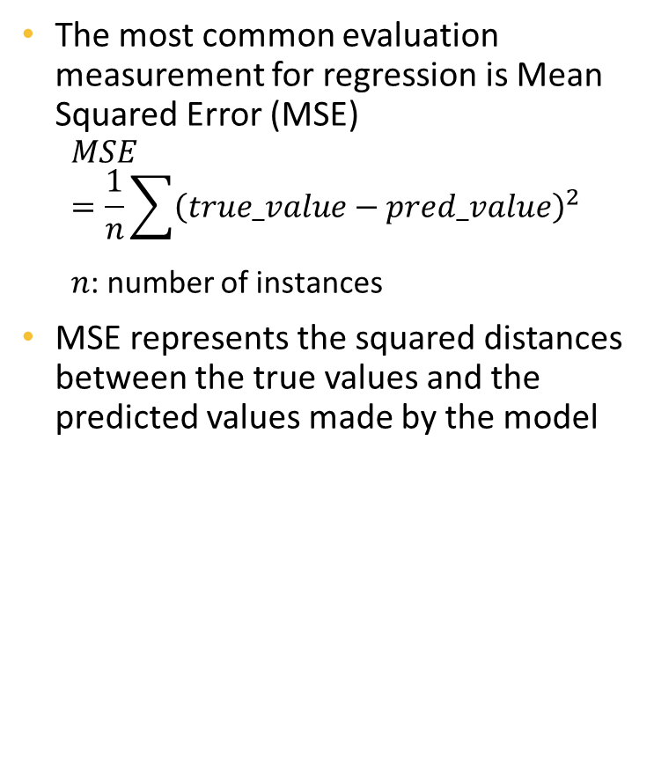
Mean Squared Error
The most common evaluation measurement for regression is Mean Squared Error (MSE)
$$MSE=\frac{1}{n}\sum{{\left(true_value−pred_value\right)}^{2}}$$
$n$: number of instances
MSE represents the squared distances between the true values and the predicted values made by the model
FYGPA
3.2
3.7
2.9
2.9
3.2
P. FYGPA
3.0
3.5
3.2
3.0
3.1
Error
0.2
0.2
-0.3
-0.1
0.1
Sq. Error
0.4
0.4
0.9
0.1
0.1
0.38
MSE

Slide 9
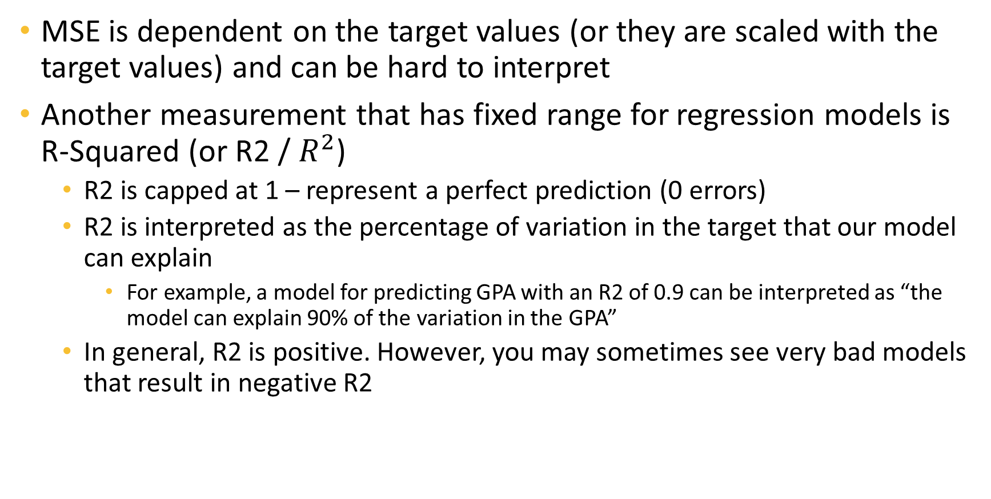
R-Squared
MSE is dependent on the target values (or they are scaled with the target values) and can be hard to interpret
Another measurement that has fixed range for regression models is R-Squared (or R2 / $R^{2}$)
R2 is capped at 1 – represent a perfect prediction (0 errors)
R2 is interpreted as the percentage of variation in the target that our model can explain
For example, a model for predicting GPA with an R2 of 0.9 can be interpreted as “the model can explain 90% of the variation in the GPA”
In general, R2 is positive. However, you may sometimes see very bad models that result in negative R2

Slide 10
Support Vector Regressor, Decision Tree, and Random Forest

Slide 11
SVR – SVM for Regression
Also called Support Vector Regression (SVR)
SVM can be modified to work on regression problems
In regression, SVR find a hyperplane that minimize the margin of data – distance between the two boundaries of the instances in this case
Instances lying on the boundaries are still called Support Vectors
Target
Input Feature
Minimized!

Slide 12
Kernel Trick in SVR
Also used to map data to an implicit higher dimensional space where data is better distributed
Kernel Trick
Original Space
High-Dimensional Space

Slide 13
SVR In SKLearn
We use SVR class
All hyperparameters are similar to SVC:
kernel – ‘poly’ for Polynomial, ‘rbf’ for RBF/Gaussian
coef0 and degree for Polynomial kernel
gamma for RBF/Gaussian
And of course, C for regularization. Again, we do not have l1 regularization in kernel SVM

Slide 14
Decision Tree and Random Forest
For regression, we use DecisionTreeRegressor and RandomForestRegressor
Model tuning is exactly the same as their classification counterparts

Slide 15
Neural Network

Slide 16




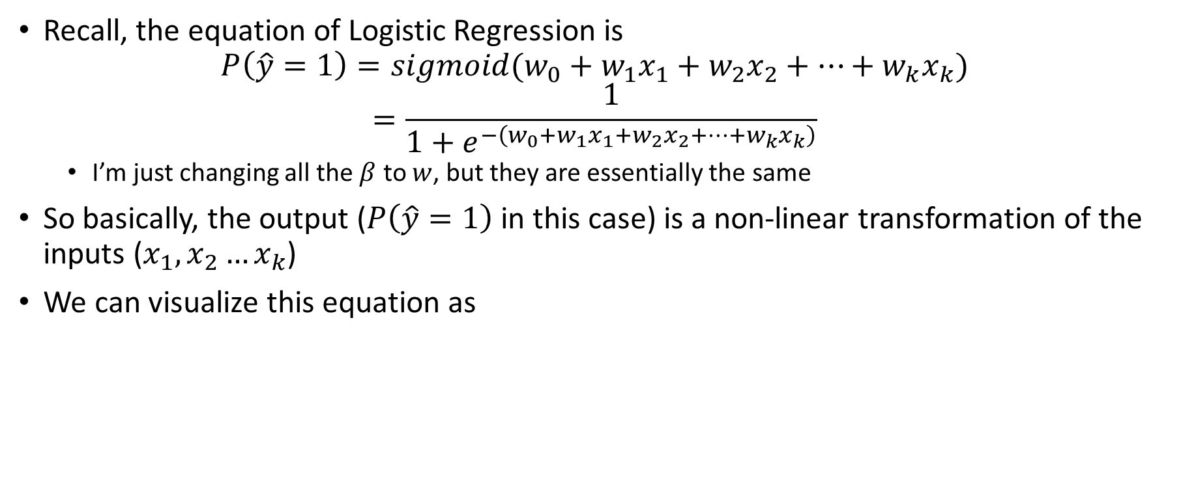






Review on Logistic Regression
Recall, the equation of Logistic Regression is
$$P\left(\hat{y}=1\right)=sigmoid(w_{0}+w_{1}x_{1}+w_{2}x_{2}+…+w_{k}x_{k})$$
$$=\frac{1}{1+e^{−\left(w_{0}+w_{1}x_{1}+w_{2}x_{2}+…+w_{k}x_{k}\right)}}$$
I’m just changing all the $β$ to $w$, but they are essentially the same
So basically, the output ($P\left(\hat{y}=1\right)$ in this case) is a non-linear transformation of the inputs ($x_{1},x_{2}…x_{k}$)
We can visualize this equation as
$$P$$
$$w_{0}$$
$$w_{1}$$
$$w_{2}$$
$$w_{3}$$
$$w_{k}$$
1
$$x_{1}$$
$$x_{2}$$
$$x_{3}$$
$$x_{k}$$

Slide 17



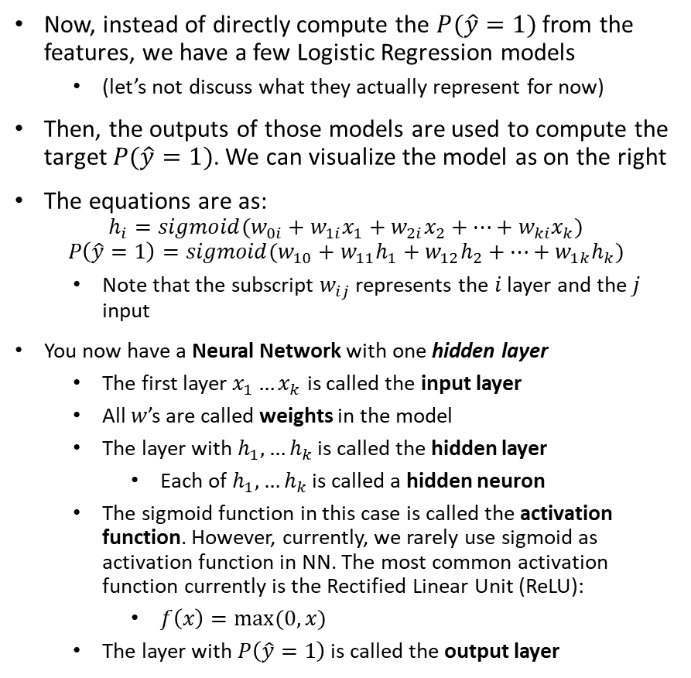





Adding a Layer
Now, instead of directly compute the $P(\hat{y}=1)$ from the features, we have a few Logistic Regression models
(let’s not discuss what they actually represent for now)
Then, the outputs of those models are used to compute the target $P(\hat{y}=1)$. We can visualize the model as on the right
The equations are as:
$$h_{i}=sigmoid(w_{0i}+w_{1i}x_{1}+w_{2i}x_{2}+…+w_{ki}x_{k})$$
$$P\left(\hat{y}=1\right)=sigmoid(w_{10}+w_{11}h_{1}+w_{12}h_{2}+…+w_{1k}h_{k})$$
Note that the subscript $w_{ij}$ represents the $i$ layer and the $j$ input
You now have a Neural Network with one hidden layer
The first layer $x_{1}…x_{k}$ is called the input layer
All $w$’s are called weights in the model
The layer with $h_{1},…h_{k}$ is called the hidden layer
Each of $h_{1},…h_{k}$ is called a hidden neuron
The sigmoid function in this case is called the activation function. However, currently, we rarely use sigmoid as activation function in NN. The most common activation function currently is the Rectified Linear Unit (ReLU):
$f\left(x\right)=max⁡(0,x)$
The layer with $P\left(\hat{y}=1\right)$ is called the output layer
$$P$$
1
$$h_{1}$$
$$h_{2}$$
$$h_{k}$$
1
$$x_{1}$$
$$x_{2}$$
$$x_{3}$$
$$x_{k}$$

Slide 18
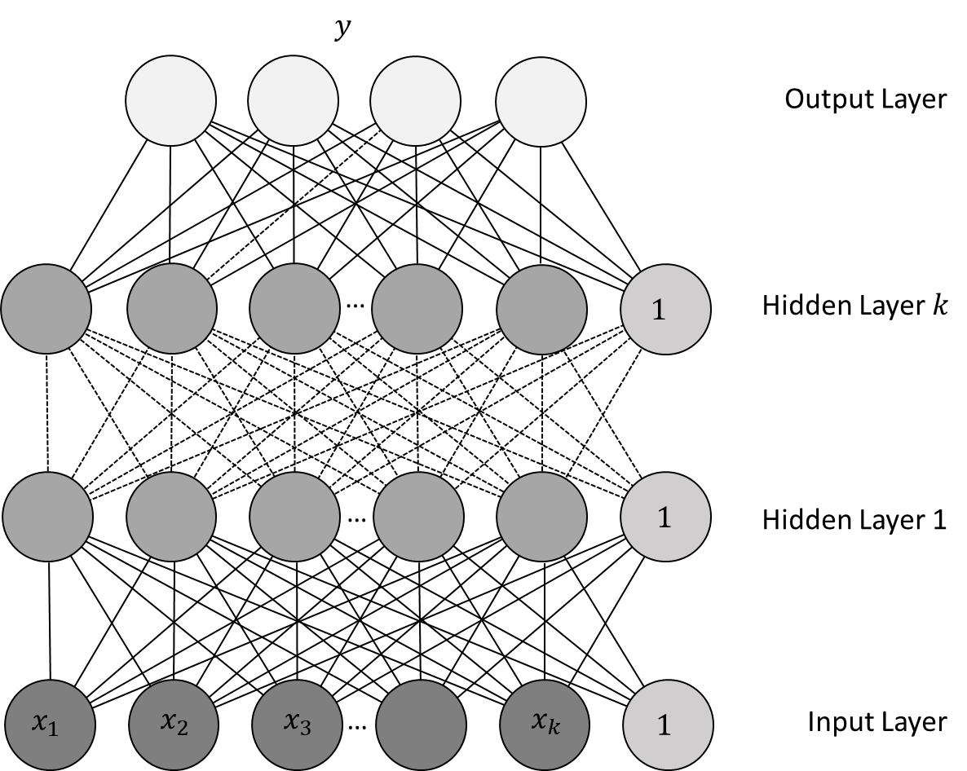
Neural Network
From the previous example, we can generalize a Neural Network as a multi-layer model
Each layer is computed as a non-linear transformation of the previous layer
The number of hidden layers and the number of hidden neurons per layer are hyper-parameters to be finetuned
The model in the output layer depends on the task, most commonly
Logistic regression for Binary Classification
SoftMax regression for Multi-label Classification
Linear regression for regression
A NN is also called a Multi-Layer Perceptron (MLP)
Similar to other machine learning models, MLP is trained to minimize a training objective, and would need regularization to prevents the weights from getting extreme values

Slide 19
Finetuning a NN/MLP
As you can see, NN models have two important hyper-parameters
Number of hidden layers
Number of neurons in each layers
This makes NNs a bit trickier to train – there are two many possibilities for these hyperparameters
Some of my personal experiences with DNN:
Deeper models are more prone to overfitting, but also are more difficult to train
Wider models (i.e. more neurons per layers) are easier to train but also easier to overfit the data
In general, we usually train networks with three to five hidden layers
The numbers of neurons in each layer are not necessarily equal to each other, however I usually use equal numbers, and also equal to a factor of number of input features
For example, if we have 5 input features, then each layer may have 5, 10, 15, or 20 neurons
In sklearn, NNs are quite a bit slower to train than other models. So, you should limit the number of architectures to try, especially when the data is large
In sklearn, we use MLPClassifier for classification, and MLPRegressor for regression

Slide 20
SageMaker XGBoost

Slide 21
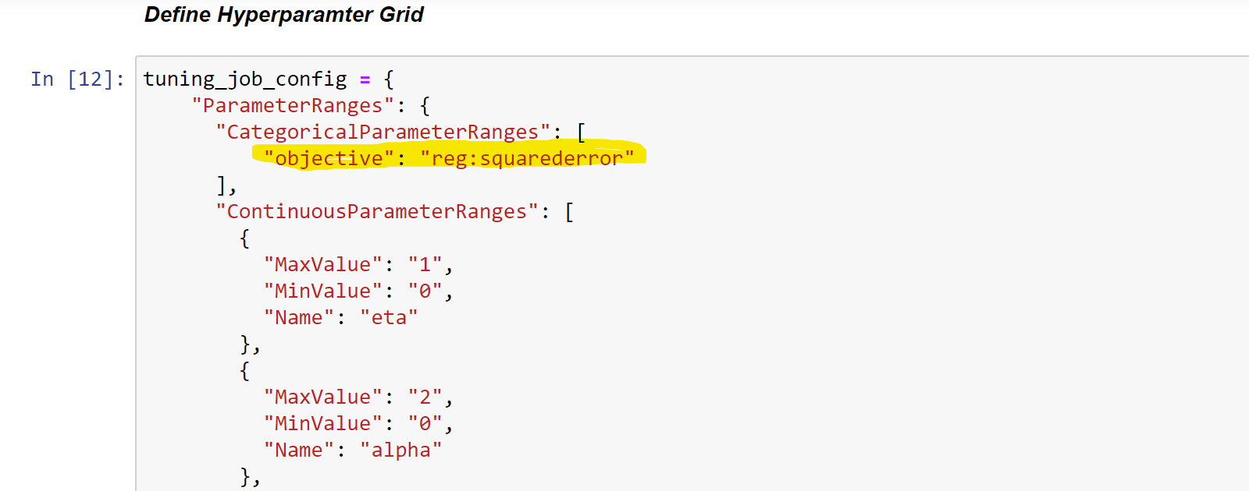
XGBoost Regressor
Is basically identical to the XGBoost Classifier
We only need to change the objective hyperparameter to “reg:meansquared”

Slide 22
Additional Reading
Linear Regression
https://www.ibm.com/topics/linear-regression
https://scikit-learn.org/stable/modules/generated/sklearn.linear_model.LinearRegression.html
Support Vector Regressor
https://cs.adelaide.edu.au/~chhshen/teaching/ML_SVR.pdf
https://scikit-learn.org/stable/modules/generated/sklearn.svm.SVR.html
Tree and Ensembles
https://scikit-learn.org/stable/auto_examples/tree/plot_tree_regression.html
https://scikit-learn.org/stable/modules/generated/sklearn.ensemble.RandomForestRegressor.html
AWS Linear Learner
https://docs.aws.amazon.com/sagemaker/latest/dg/linear-learner.html

